Slide 1

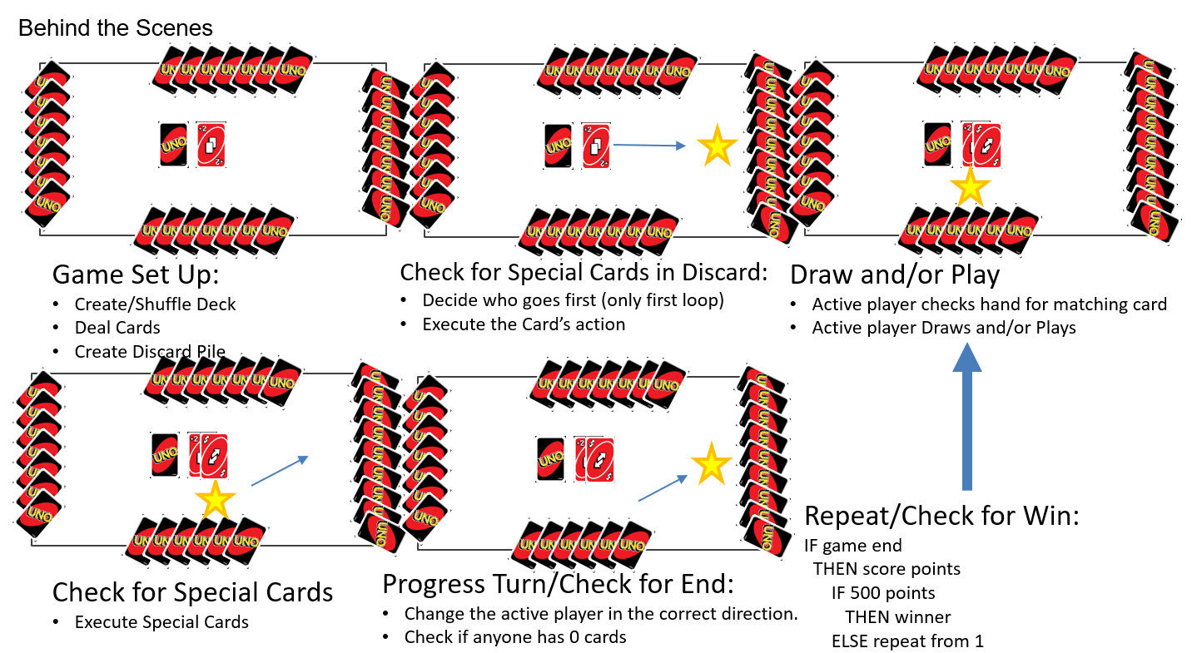
Uno Milestone
Gage Zahn | Dennis Attawia | Grand Canyon University
Milestone 1
Outlined structure of the project via a flowchart and storyboard.
Worked out the logic required.

Slide 2
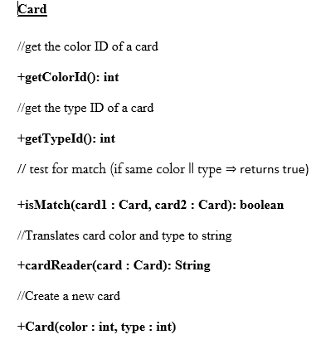
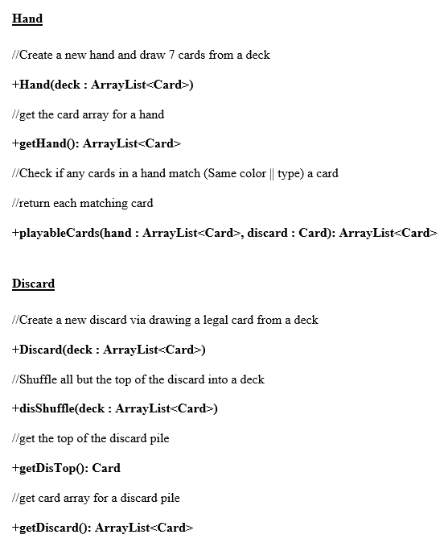
Uno Milestone
Gage Zahn | Dennis Attawia | Grand Canyon University
Milestone 2
Documented classes and methods that may be required for final project.

Slide 3
Uno Milestone
Gage Zahn | Dennis Attawia | Grand Canyon University
Milestone 3
Created the code foundation for the final project
Made partial Hand, Deck, and Card Classes
class Card{
int typeId;
int colorId;
public Card(int type,int color){
this.typeId=type;
this.colorId=color;
}
static public String cardReader (Card input) {
String color="";
String type="";
String cardValue;
//Decrypt Type
if(input.typeId < 10)
type=String.valueOf(input.typeId);
if (input.typeId == 10)
type="Reverse";
if (input.typeId == 11)
type="Skip";
if (input.typeId == 12)
type="Draw 2";
if (input.typeId == 13)
type="Wild";
if (input.typeId == 14)
type="Wild Draw 4";
if (input.typeId == -1)
type = "NONE";
//Decrypt Color
if(input.colorId == 0)
color="Red";
if (input.colorId == 1)
color="Yellow";
if (input.colorId == 2)
color="Green";
if (input.colorId == 3)
color="Blue";
if (input.colorId == 4)
color = "ALL";
if (input.colorId == -1)
color = "NONE";
//Return Card
cardValue= color + "\t" + type;
return cardValue;
}
}
class Hand{
private ArrayList<Card> hand;
public Hand(Deck deck) {
hand = new ArrayList<Card>();
for(int i = 0; i < 7; i++)
hand.add(deck.draw(deck.getDeck()));
}
public ArrayList<Card> getHand() {
return hand;
}
}

Slide 4
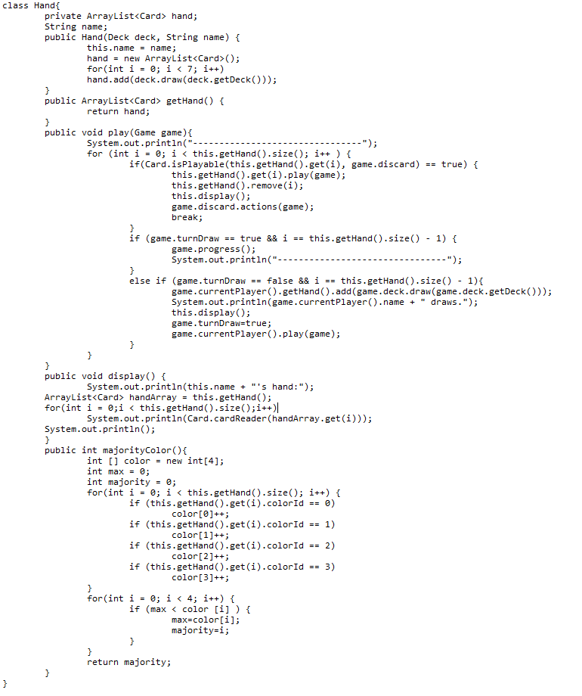
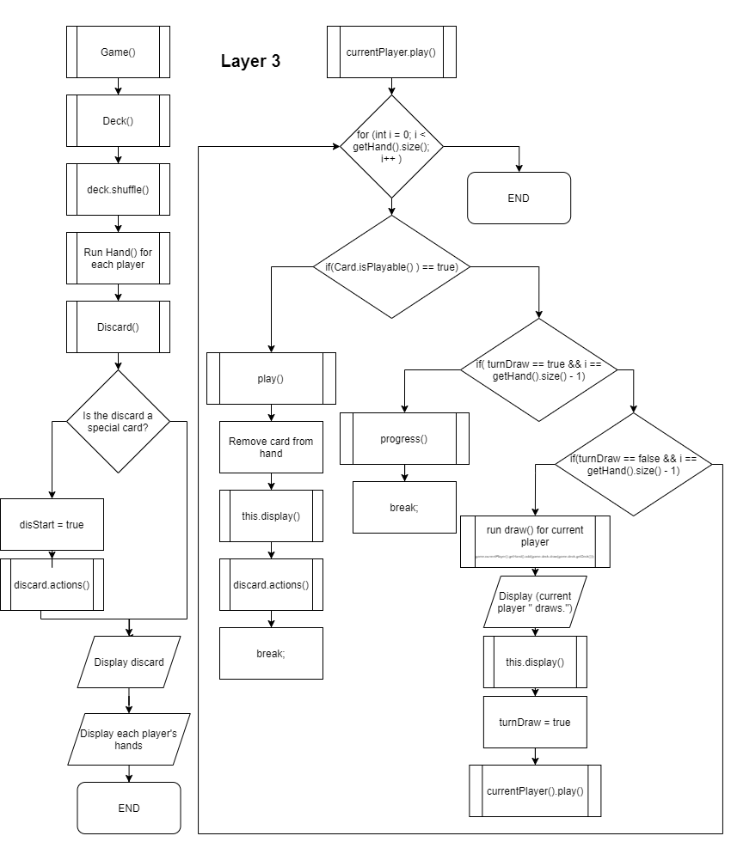
Uno Milestone
Gage Zahn | Dennis Attawia | Grand Canyon University
Milestone 4
Created minimum viable product (MVP)
Expanded functionality of Hand, Card and Deck Classes
Added Match, Game, and Discard Classes

Slide 5
Uno Milestone
Gage Zahn | Dennis Attawia | Grand Canyon University
Milestone 5
Refined the end user experience
Recapped project
------------New Game------------
Discard Pile: ALL Wild
P2 chooses Green Wild
P1's hand:
Green Draw 2
Red 2
Green 3
Yellow 7
Blue Draw 2
Blue 8
Yellow 0
P2's hand:
Green 4
Yellow 2
Yellow 1
Blue 5
Green 5
Red 9
Green 2
P3's hand:
Red 4
Blue 7
Red 4
Yellow 6
Blue 3
Yellow 8
Yellow 4
…
P4's Turn:
Discard Pile: Blue Wild Draw 4
P4 plays: Blue 2
P4's hand:
Green 1
Blue Reverse
Blue 9
Red 1
Blue 0
Yellow 8
--------------------------------------------
P1's Turn:
Discard Pile: Blue 2
P1 plays: Blue 8
P1's hand:
Empty
P1 ran out of cards and wins this round!
P1's round score: 173
--------------------------------------------
Player 1 has 173 points.
Player 2 has 0 points.
Player 3 has 0 points.
Player 4 has 0 points.
P2's Turn:
Discard Pile: Red Draw 2
P2 plays: Red 4
P2's hand:
Blue 4
P2 Says 'UNO!'
--------------------------------------------
P1's Turn:
Discard Pile: Red 4
P1 plays: Red Reverse
P1's hand:
Empty
Reverse!
P1 ran out of cards and wins this round!
P1's round score: 201
--------------------------------------------
Player 1 ended the match with 566 points and won!
Player 2 ended the match with 115 points.
Player 3 ended the match with 241 points.
Player 4 ended the match with 423 points.

